Slide 1
BB2950 Day 24: Thursday 12-7-17
Learning objectives:
Describe the process of elongation, including the roles of elongation factors EF-Tu, EF-Ts, and EF-G (continued from Tuesday).
Describe the chemical basis of peptide bond formation (continued from Tuesday).
Describe how translation is terminated, including the roles of the release factors.
Describe how ribosomes are prepared for re-use, including the role of ribosome recycling factor.
Explain how proteins are targeted to the correct sub-cellular locations.
Explain what post-translational modification is and why its important.

Slide 2
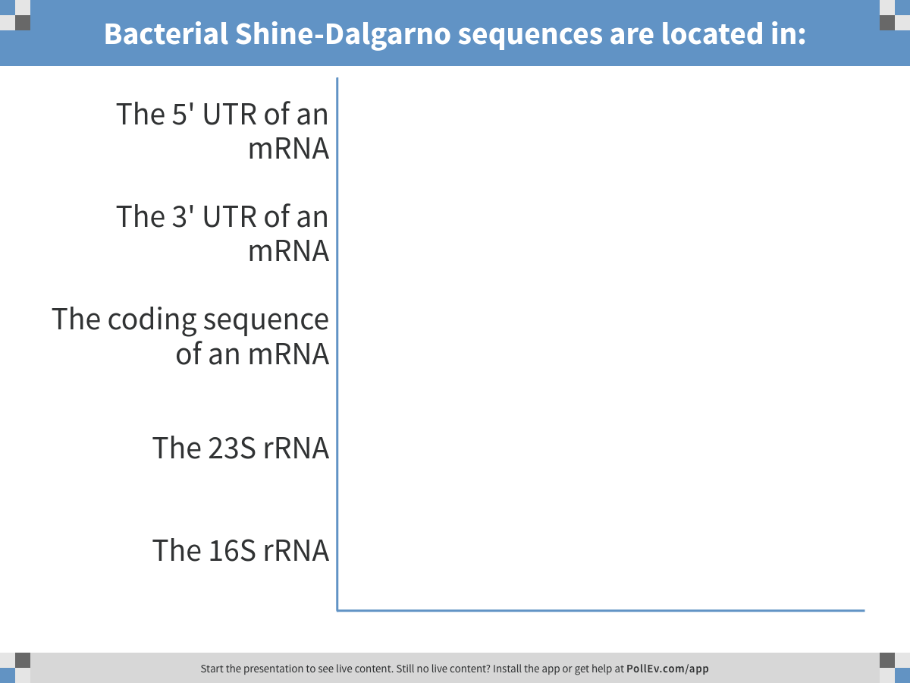
Notes:
Bacterial Shine-Dalgarno sequences are located in:
https://www.polleverywhere.com/multiple_choice_polls/VPhZYPbGknOFLvM

Slide 3
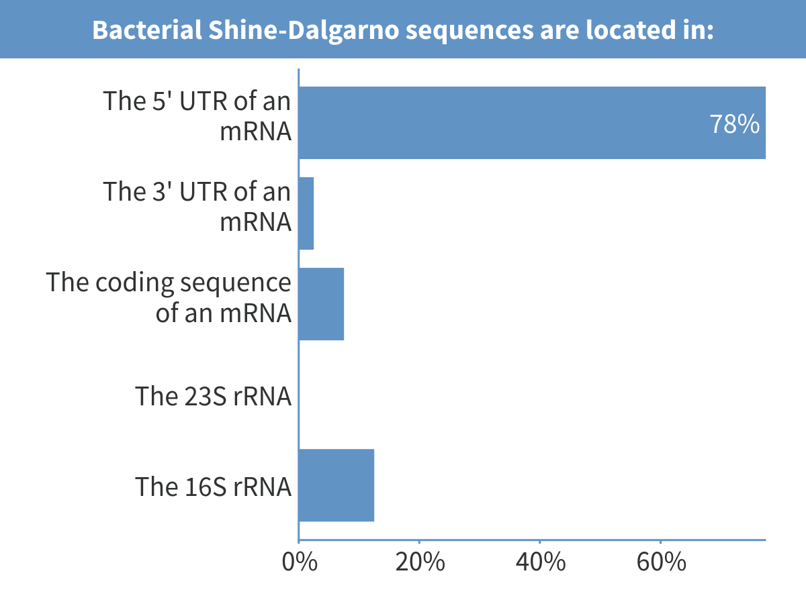
Notes:
Bacterial Shine-Dalgarno sequences are located in:

Slide 4
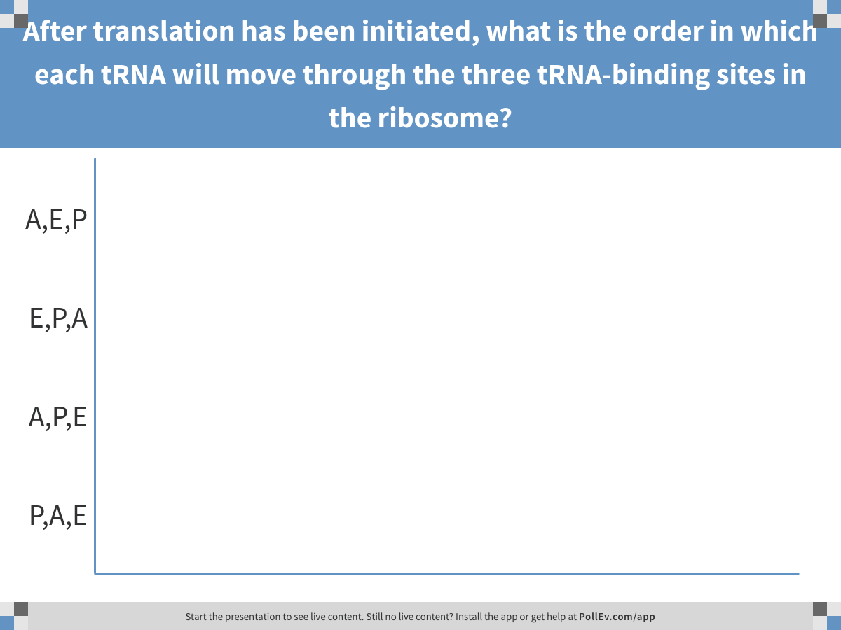
Notes:
After translation has been initiated, what is the order in which each tRNA will move through the three tRNA-binding sites in the ribosome?
https://www.polleverywhere.com/multiple_choice_polls/aQeMslDYEsl5Bav

Slide 5
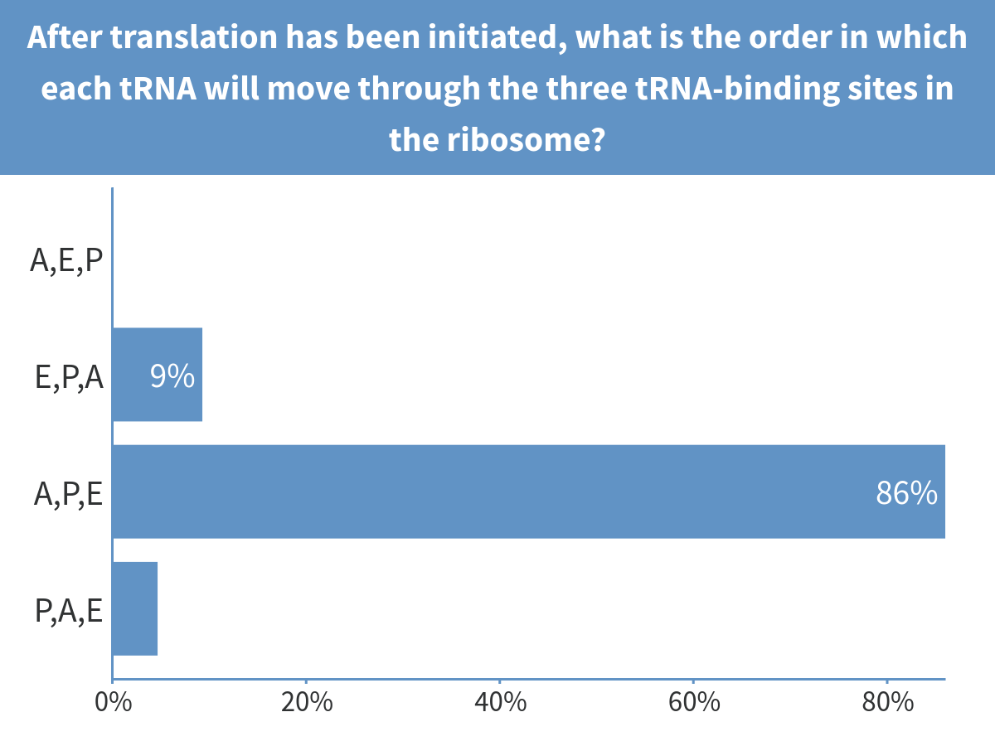
Notes:
After translation has been initiated, what is the order in which each tRNA will move through the three tRNA-binding sites in the ribosome?

Slide 6
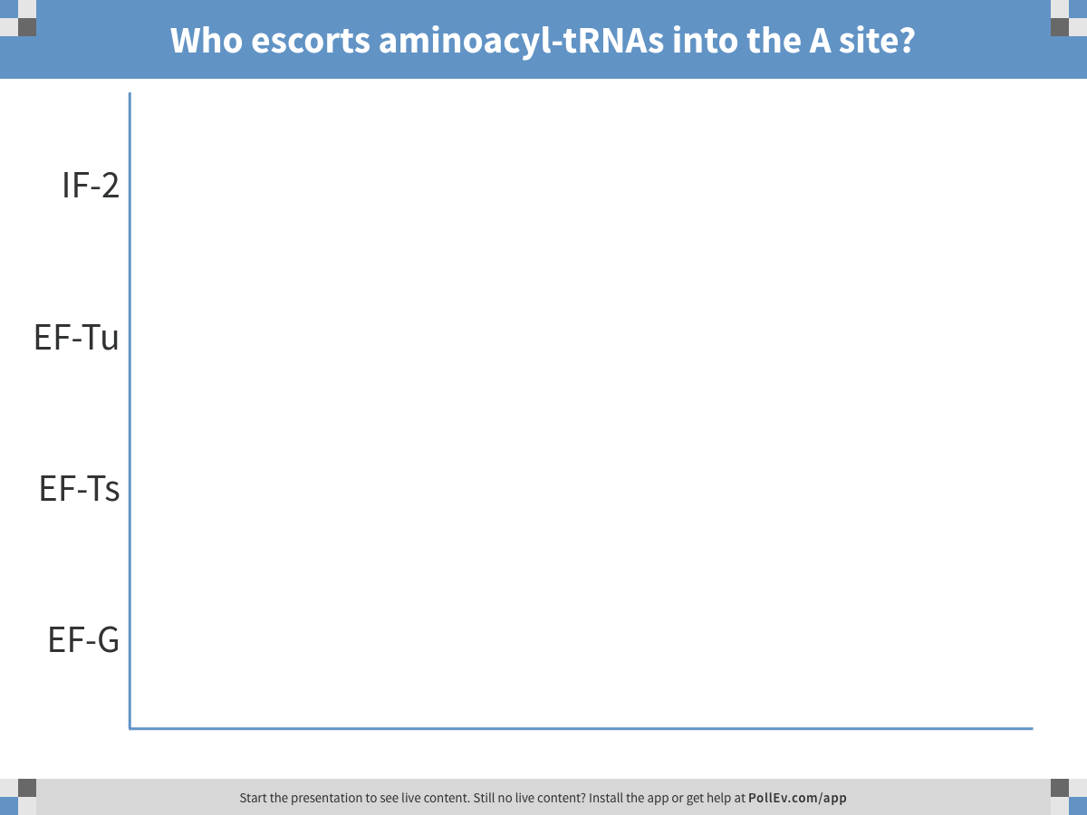
Notes:
Who escorts aminoacyl-tRNAs into the A site?
https://www.polleverywhere.com/multiple_choice_polls/NsNDZzN7O7e89e7

Slide 7
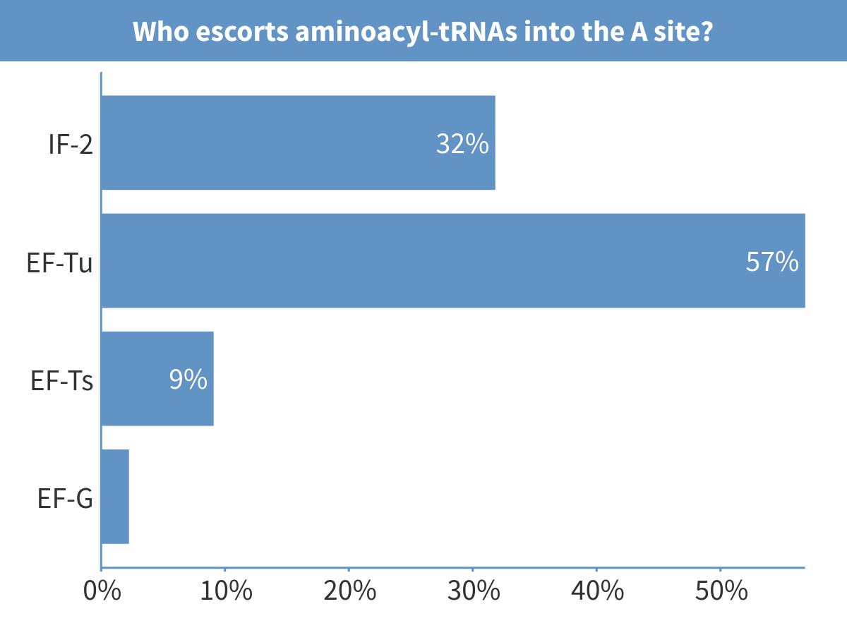
Notes:
Who escorts aminoacyl-tRNAs into the A site?

Slide 8
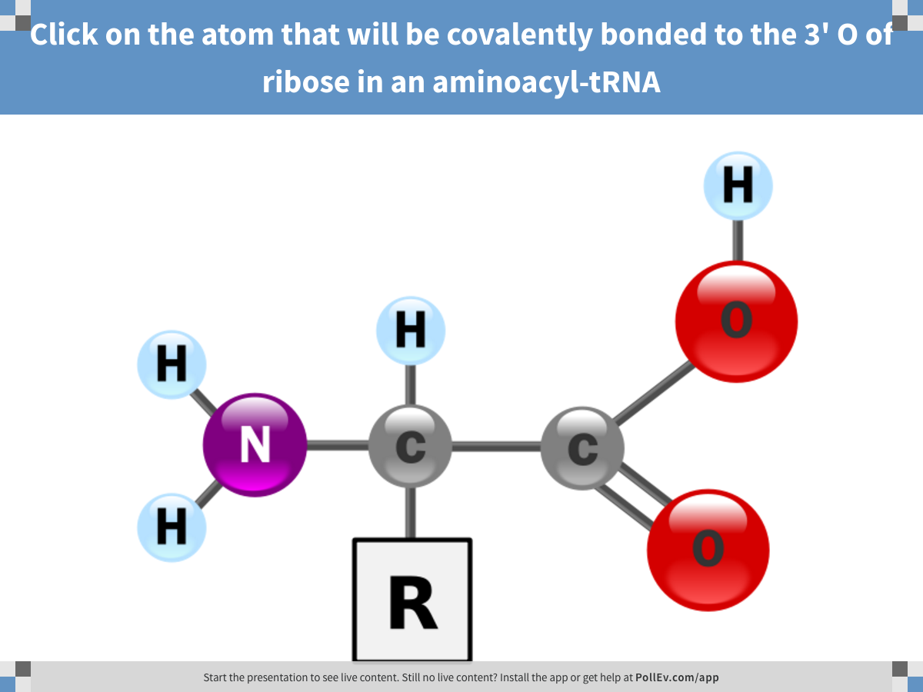
Notes:
Click on the atom that will be covalently bonded to the 3' O of ribose in an aminoacyl-tRNA
https://www.polleverywhere.com/clickable_images/imPd2TI0mHjUbyJ

Slide 9
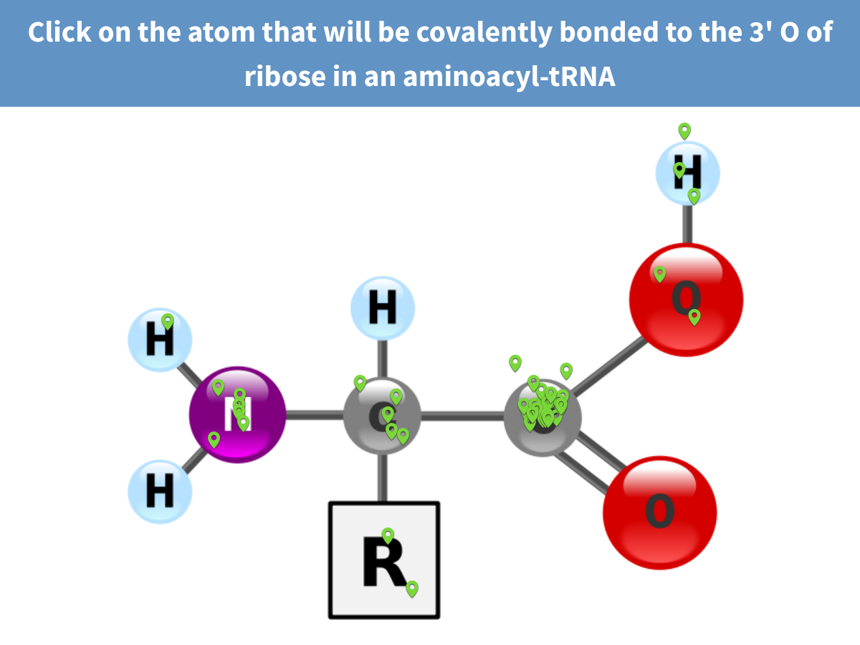
Notes:
Click on the atom that will be covalently bonded to the 3' O of ribose in an aminoacyl-tRNA

Slide 10
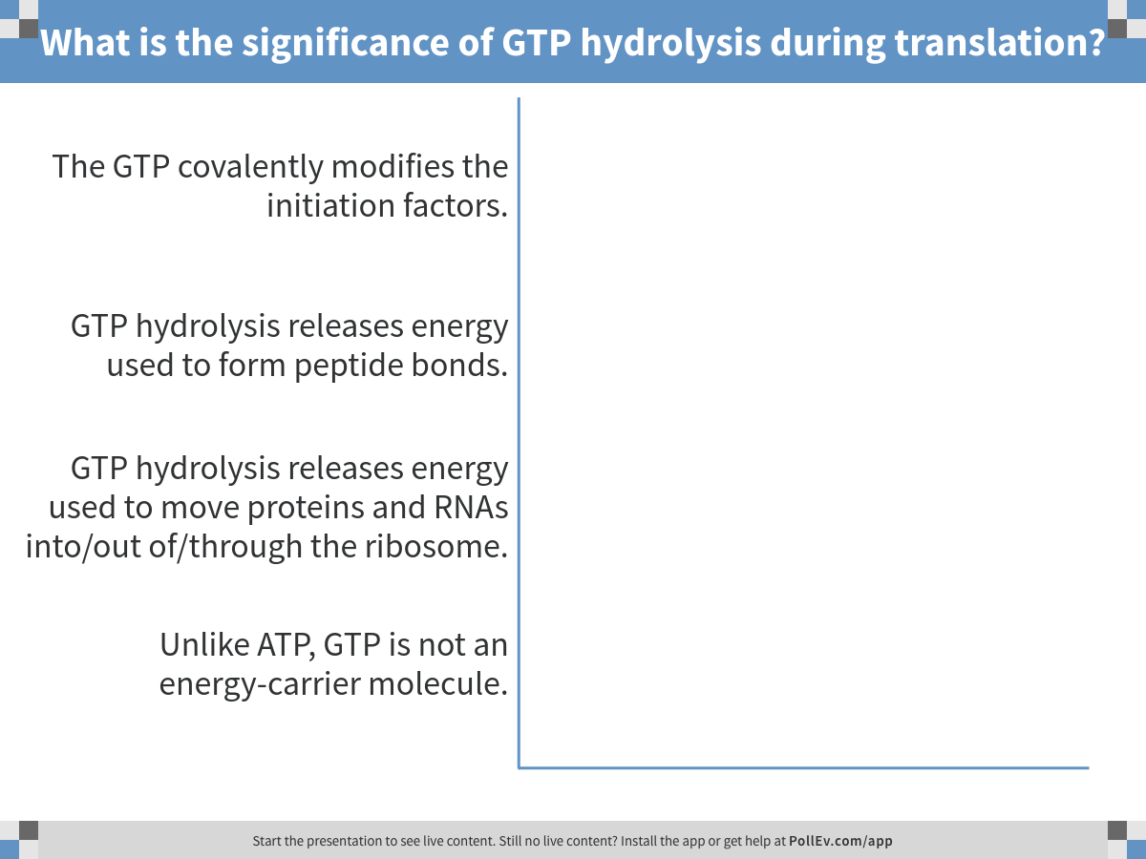
Notes:
What is the significance of GTP hydrolysis during translation?
https://www.polleverywhere.com/multiple_choice_polls/Yfujt7q8R91wBUl

Slide 11
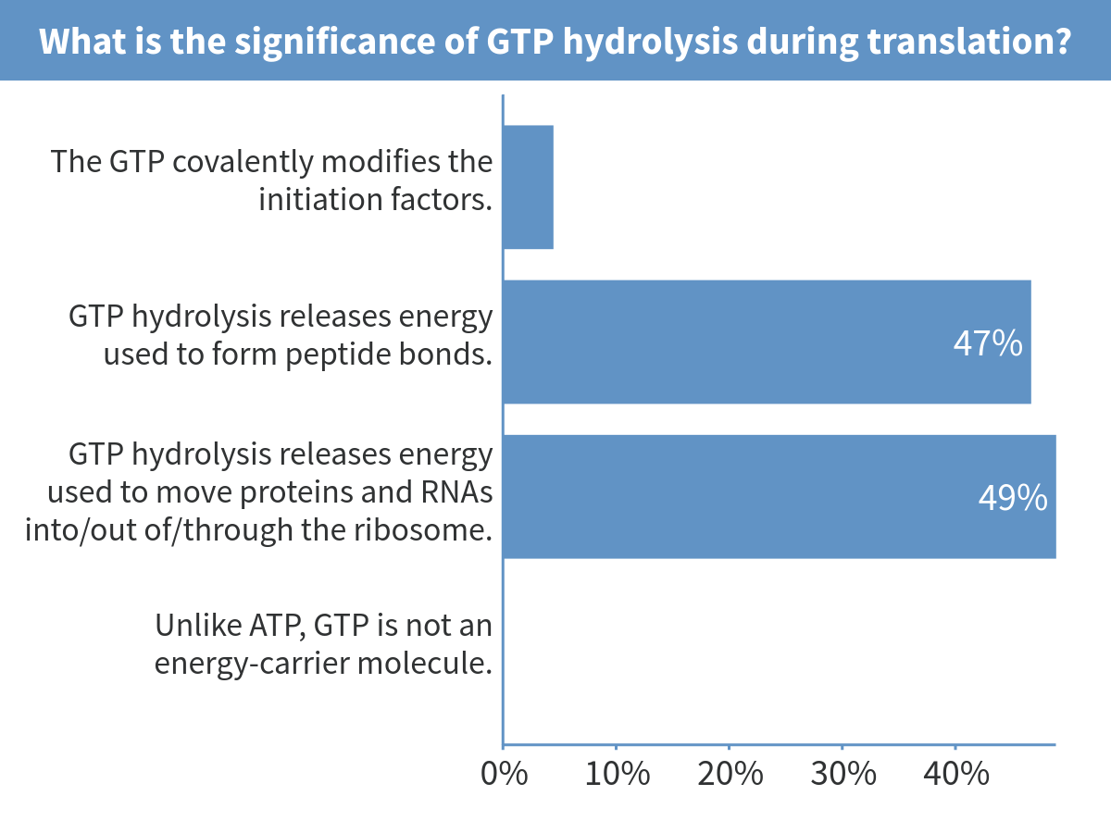
Notes:
What is the significance of GTP hydrolysis during translation?

Slide 12
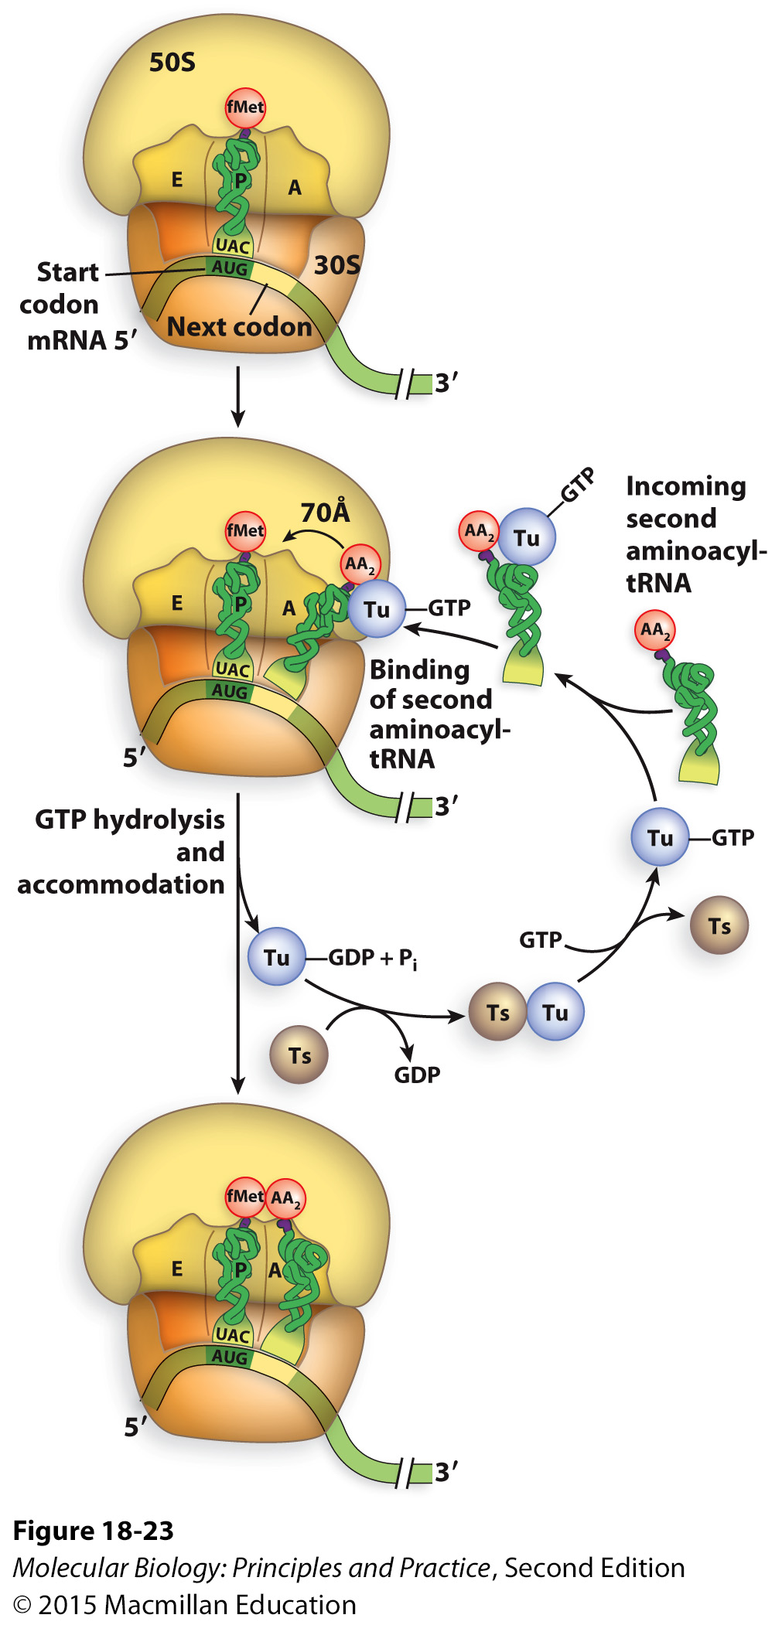
Elongation requires Elongation Factors (EFs) and GTP hydrolysis
GTP hydrolysis by EF-Tu triggers a conformational change in EF-Tu that causes it to dissociate from the ribosome.
After EF-Tu dissociates, the amino acid arm of the tRNA moves into the active site of the ribosome.
Notes:
EF-Tu: bringing in new tRNA
As in initiation, tRNAs don’t enter the ribosome spontaneously – need proteins to bring them in.
EF-Ts: guanine nucleotide exchange factor.

Slide 13
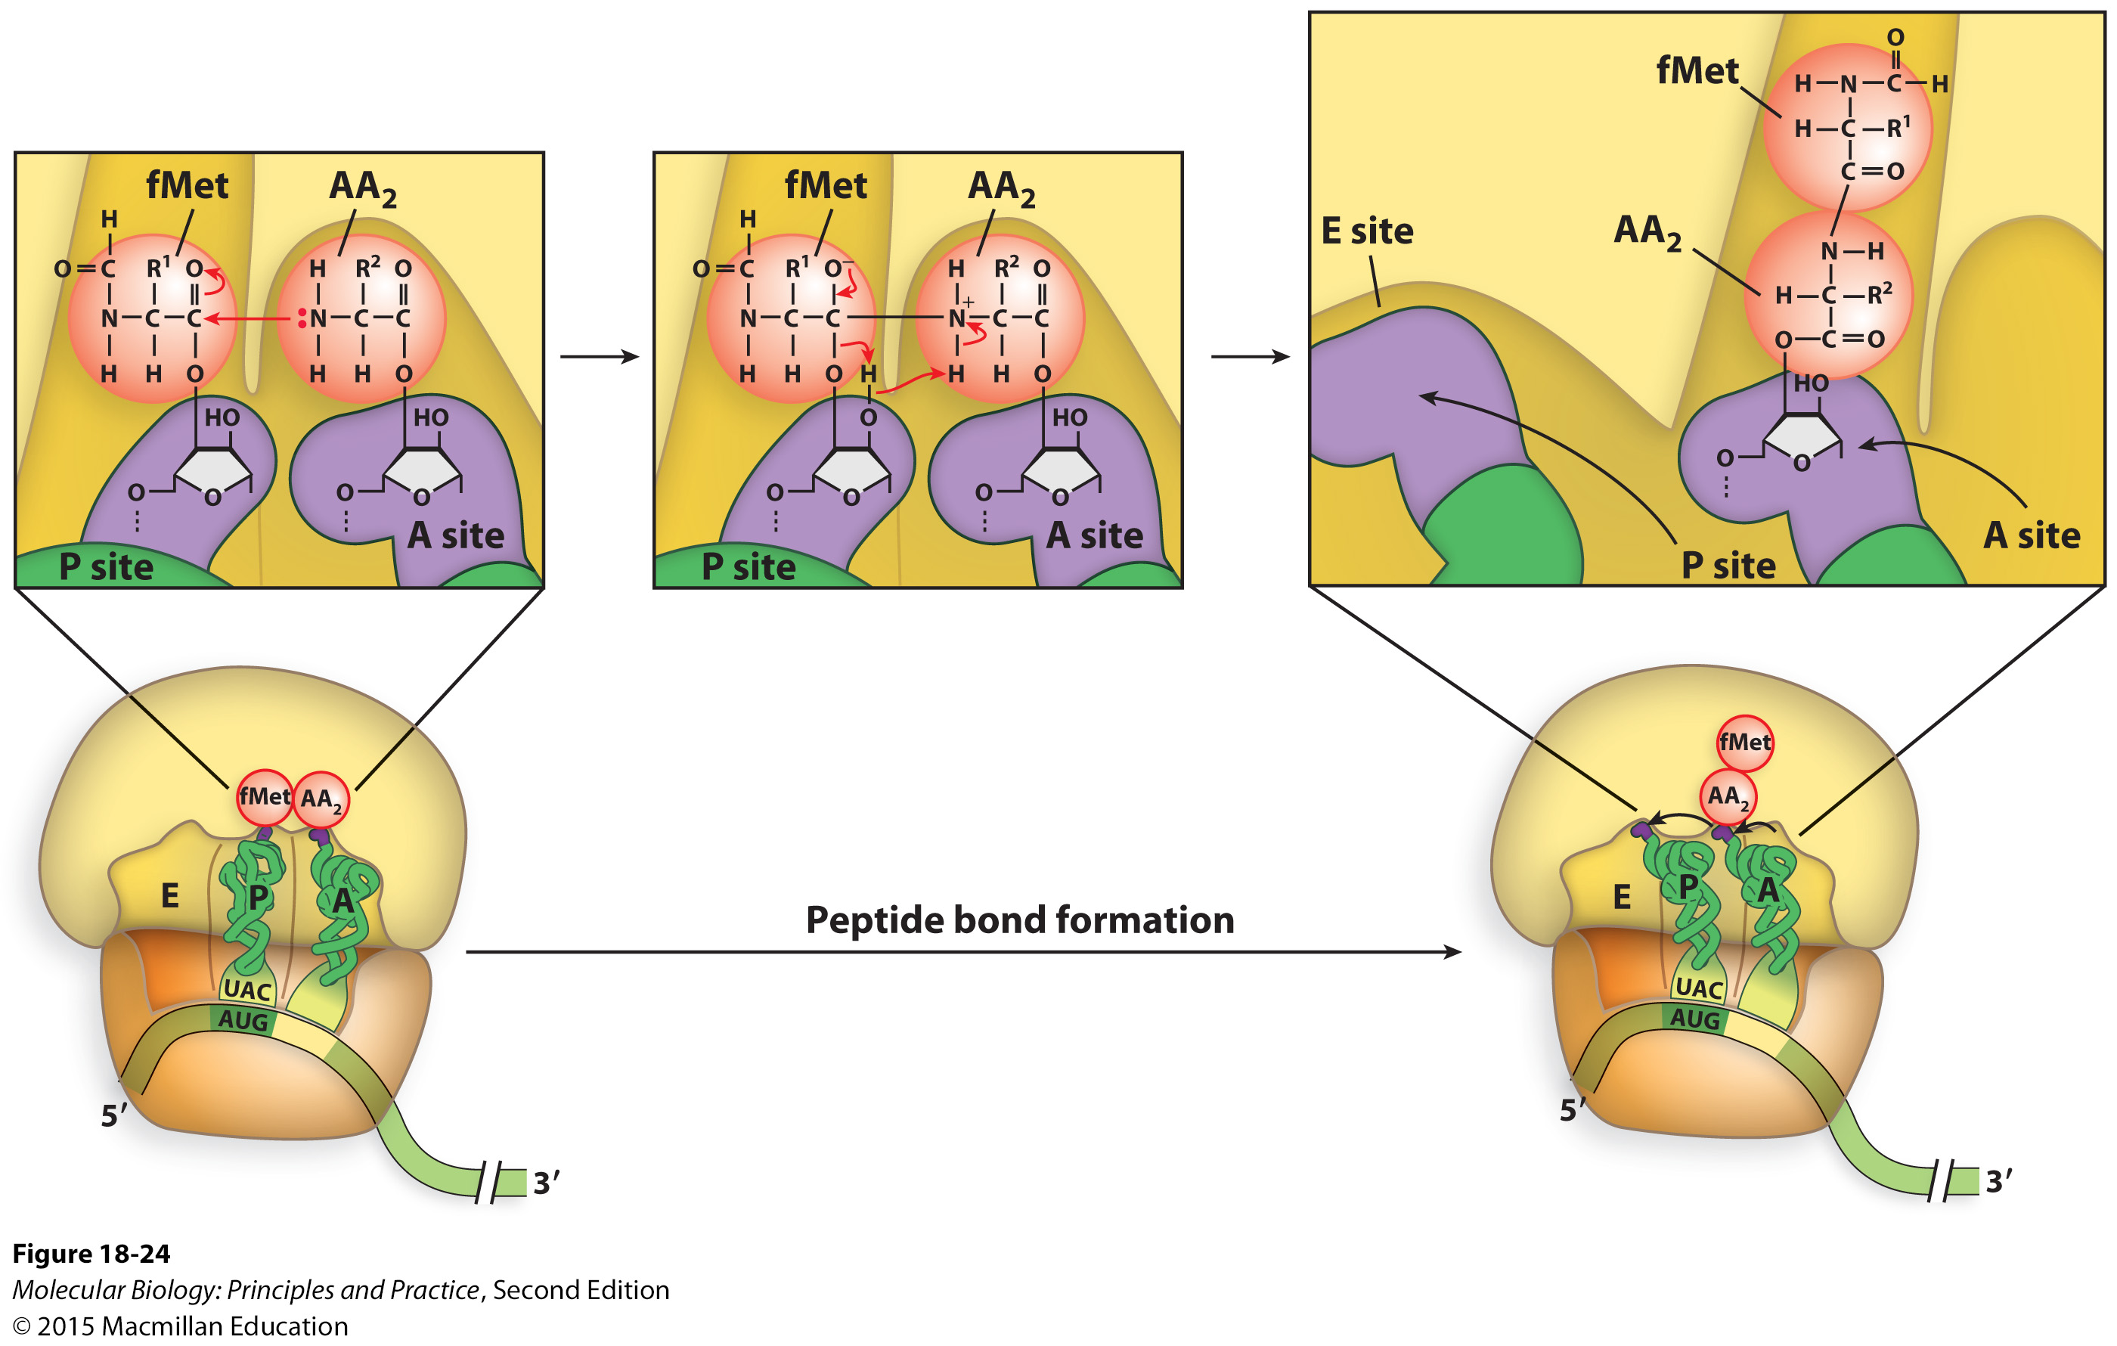
The chemistry of peptide bond formation
Notes:
The bond between the amino acid and the tRNA at the P site is broken
The C-term of the P-site amino acid or peptide is joined to the N-term of the amino acid in the A site
The amino acid or peptide that was in the P site is now covalently linked to the amino acid that is covalently linked to the tRNA in the A site

Slide 14
Notes:
The amino N attacks the carbonyl C.
Some shuffling around of electrons and protons.
3’ OH of P-site tRNA is restored (not shown)
A site tRNA is now “leaning” towards P site.

Slide 15
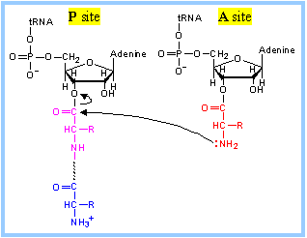
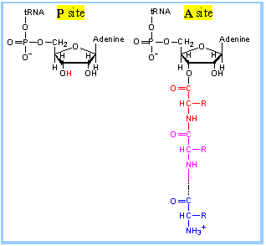
A slightly more simplified view of the peptidyl transfer reaction
http://rpi.edu/dept/bcbp/molbiochem/MBWeb/mb2/part1/translate.htm

Slide 16
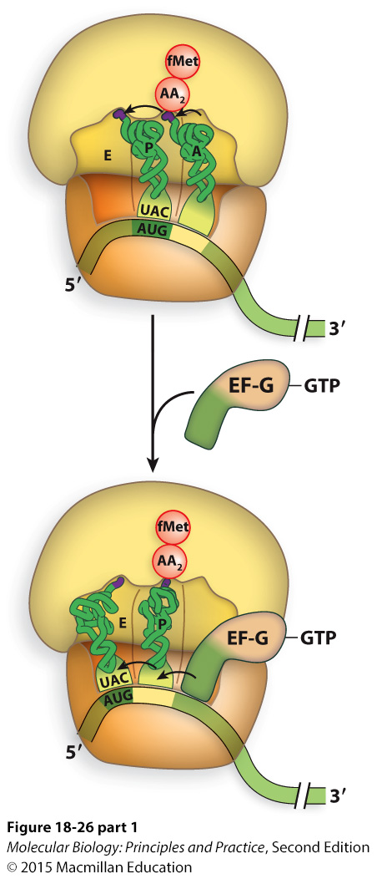
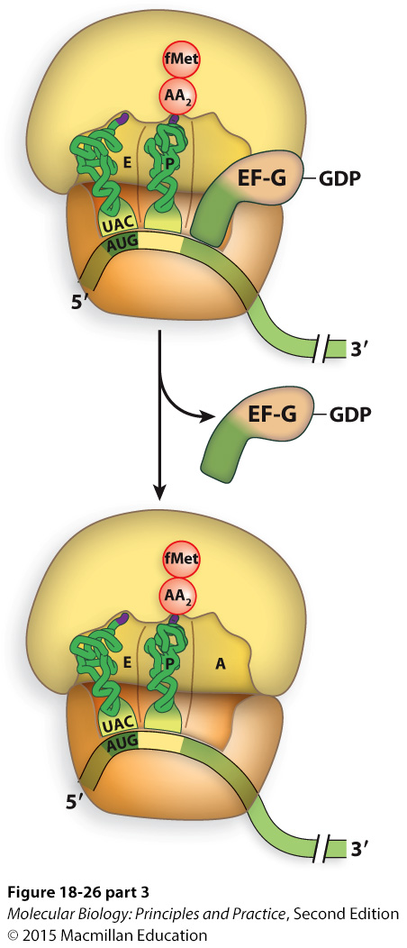
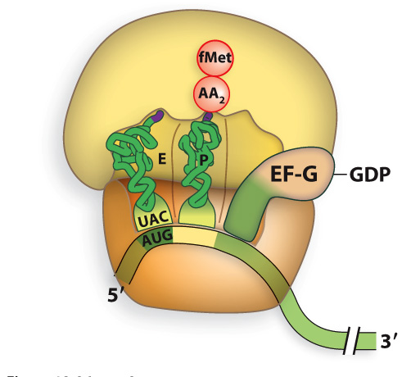
Translocation of the ribosome along the mRNA requires EF-G and GTP hydrolysis
GTP hydrolysis
Notes:
GTP hydrolysis powers the movement of the ribosome along the mRNA

Slide 17
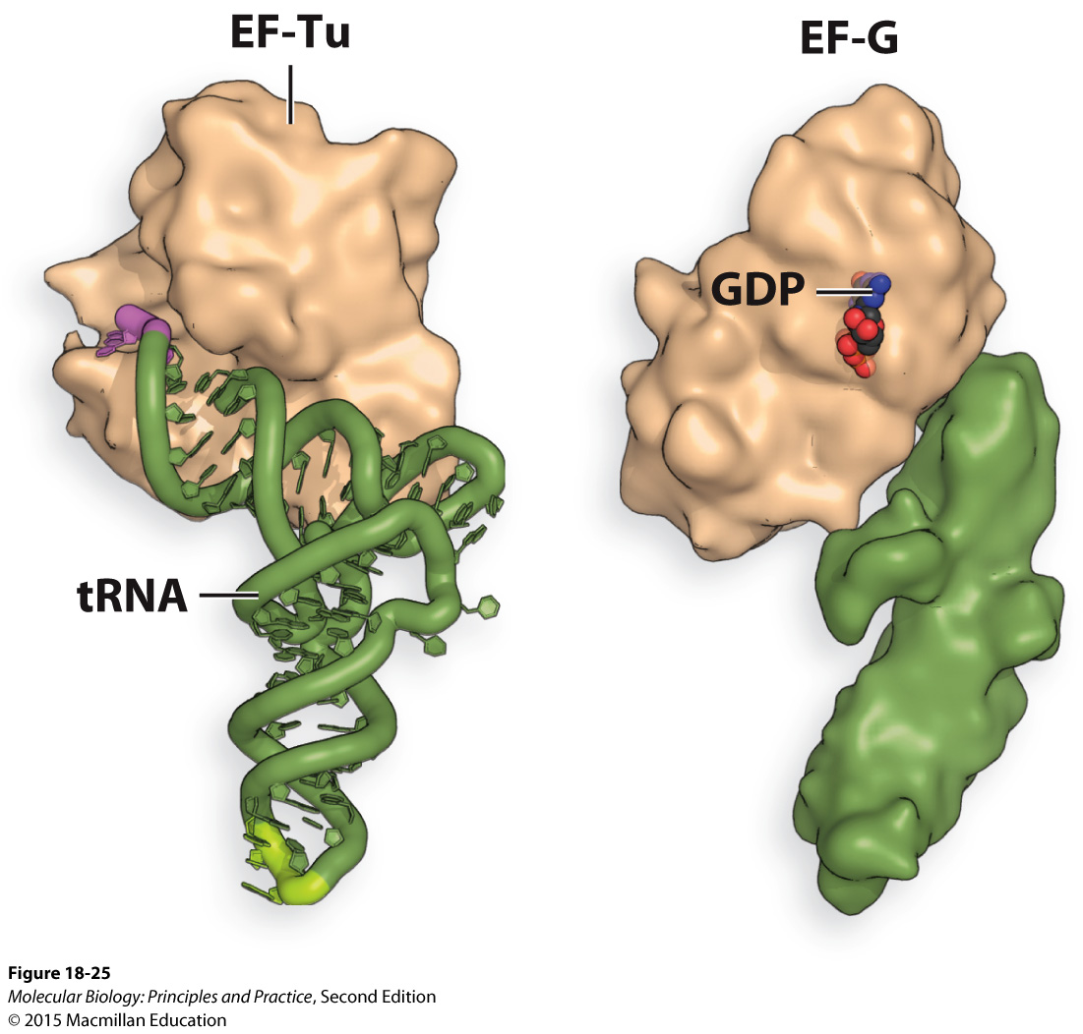
The three-dimensional structure of EF-G is similar to that of a tRNA bound to EF-Tu

Slide 18
Elongation in eukaryotes occurs in essentially the same way, but the EFs have different names:
Bacteria | Eukaryotes
EF-Tu | eEF1α
EF-Ts | eEF1β
EF-G | eEF2

Slide 19
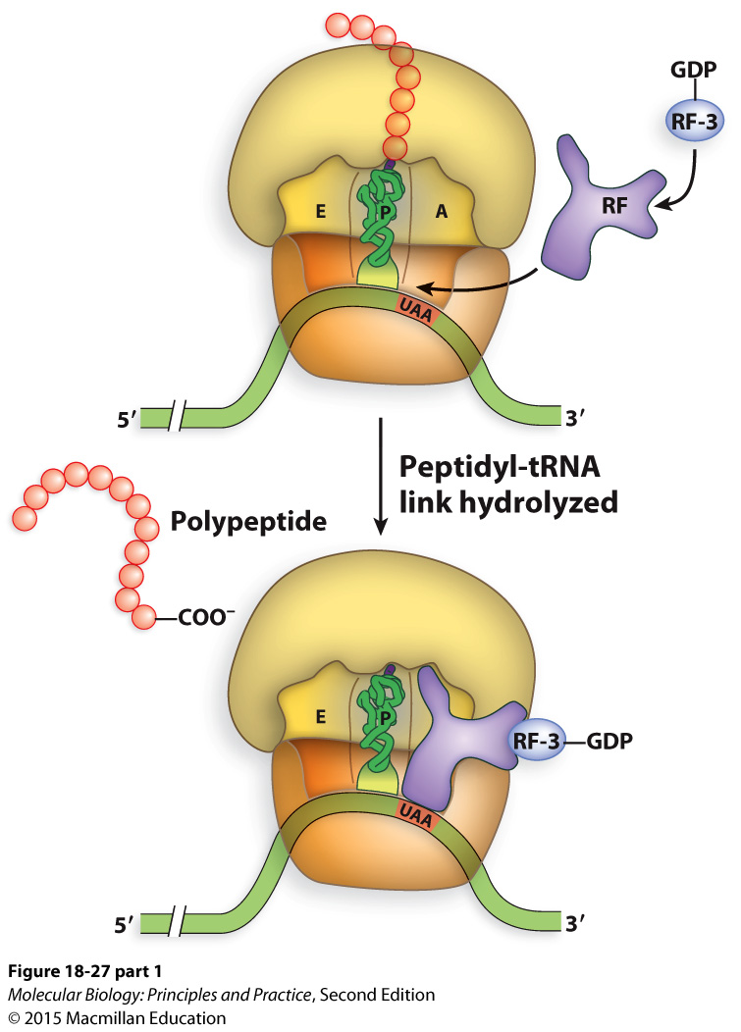
Termination of translation requires Release Factors (RFs) to catalyze hydrolysis of the bond between the last amino acid and the last tRNA
Notes:
Why can’t the finished polypeptide just dissociate?

Slide 20
RF-1 or RF-2 bind along with RF-3 and stimulate hydrolysis of the bond between the polypeptide and the last tRNA
Notes:
Like EF-G, RF1/2 have tRNA-like structures.

Slide 21
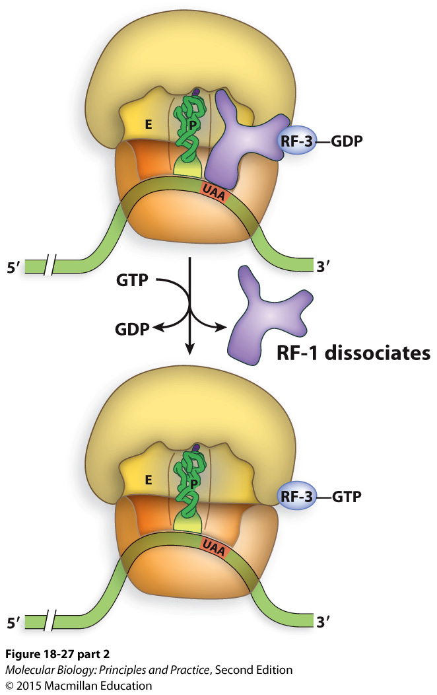
Exchange of GDP for GTP causes RF-1 or RF-2 to dissociate

Slide 22
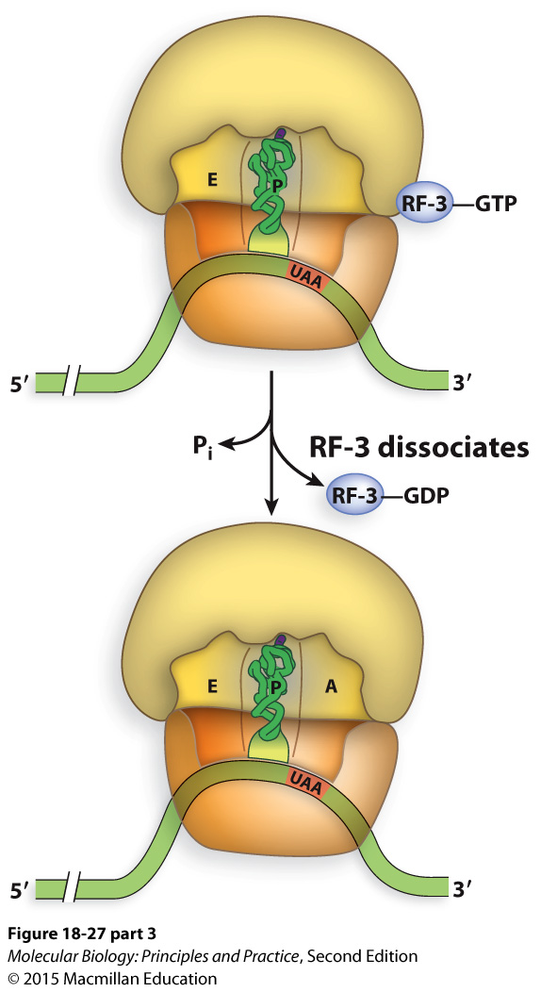
Hydrolysis of GTP causes RF-3 to dissociate

Slide 23
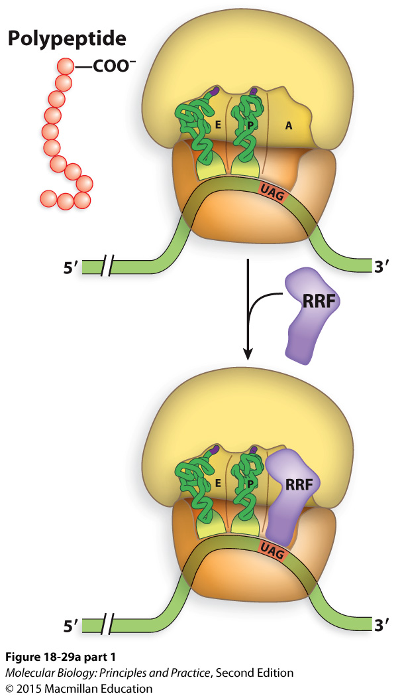
Ribosome Recycling Factor (RRF) is required to remove the remaining uncharged tRNA and mRNA so that ribosomes can be re-used

Slide 24
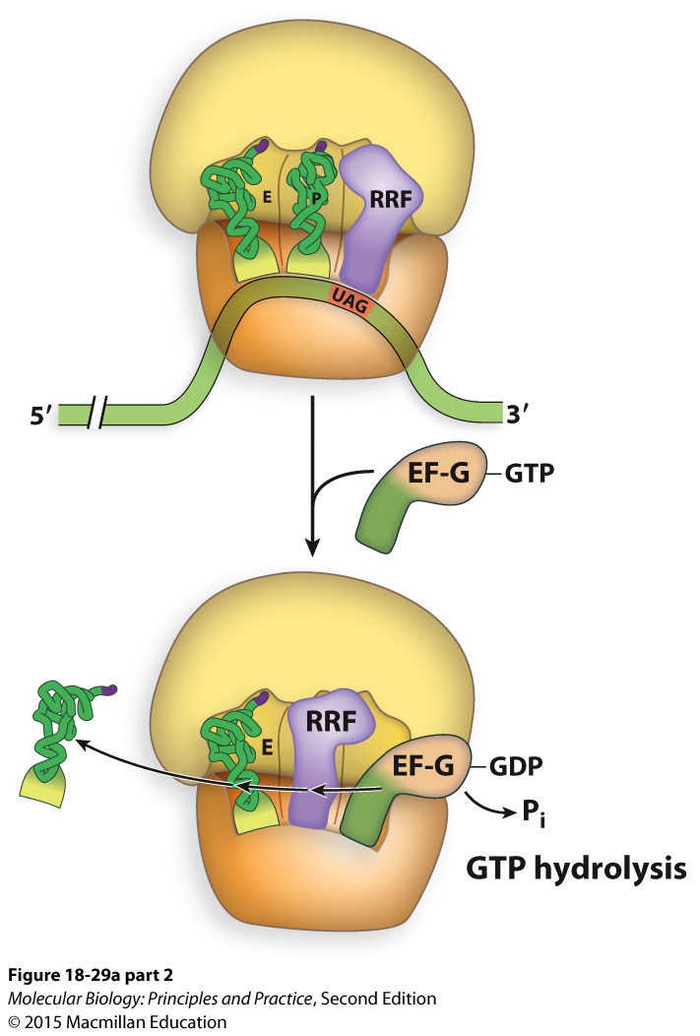
After RRF binds in the A site, EF-G comes into A site and pushes RRF over just as it would a tRNA
(causes the ribosome to translocate along mRNA)

Slide 25
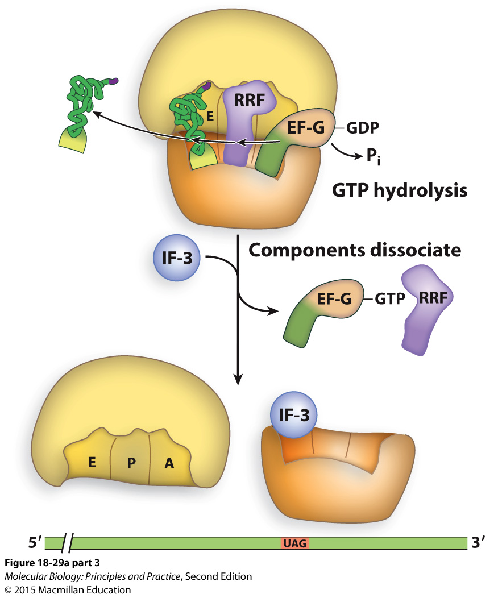
RRF in the P site induces disassembly of the ribosome

Slide 26
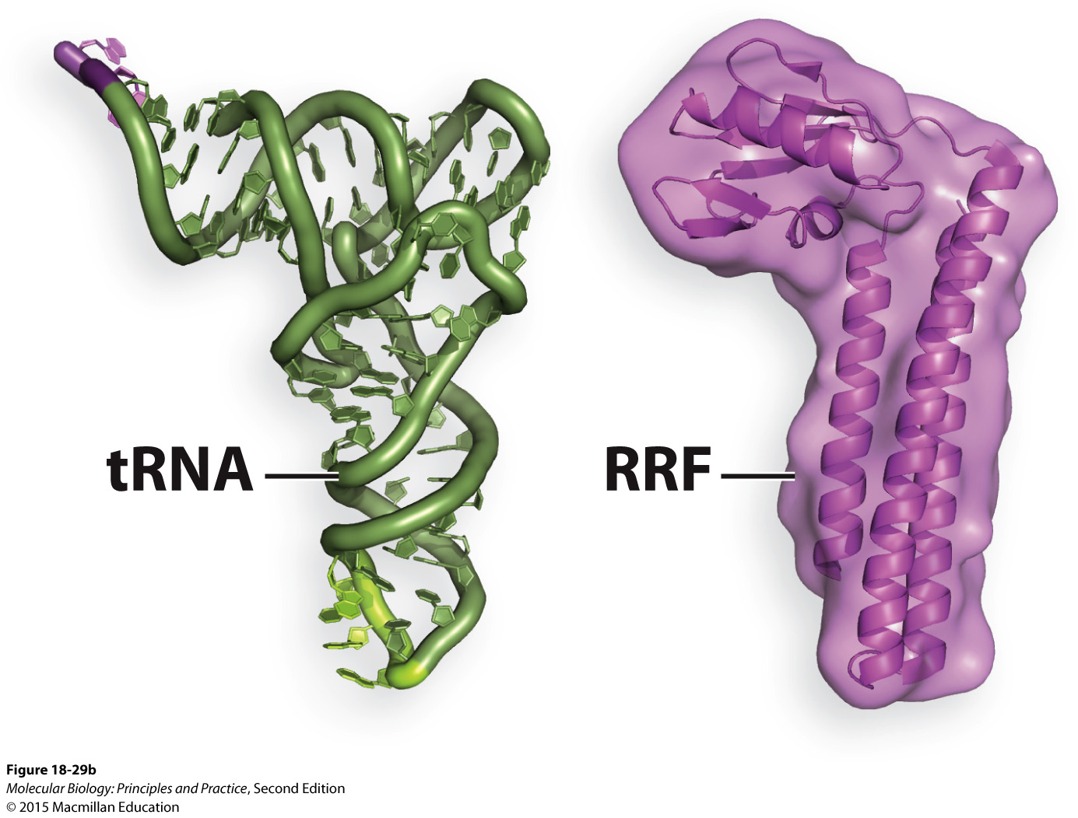
RRF is structurally similar to a tRNA

Slide 27
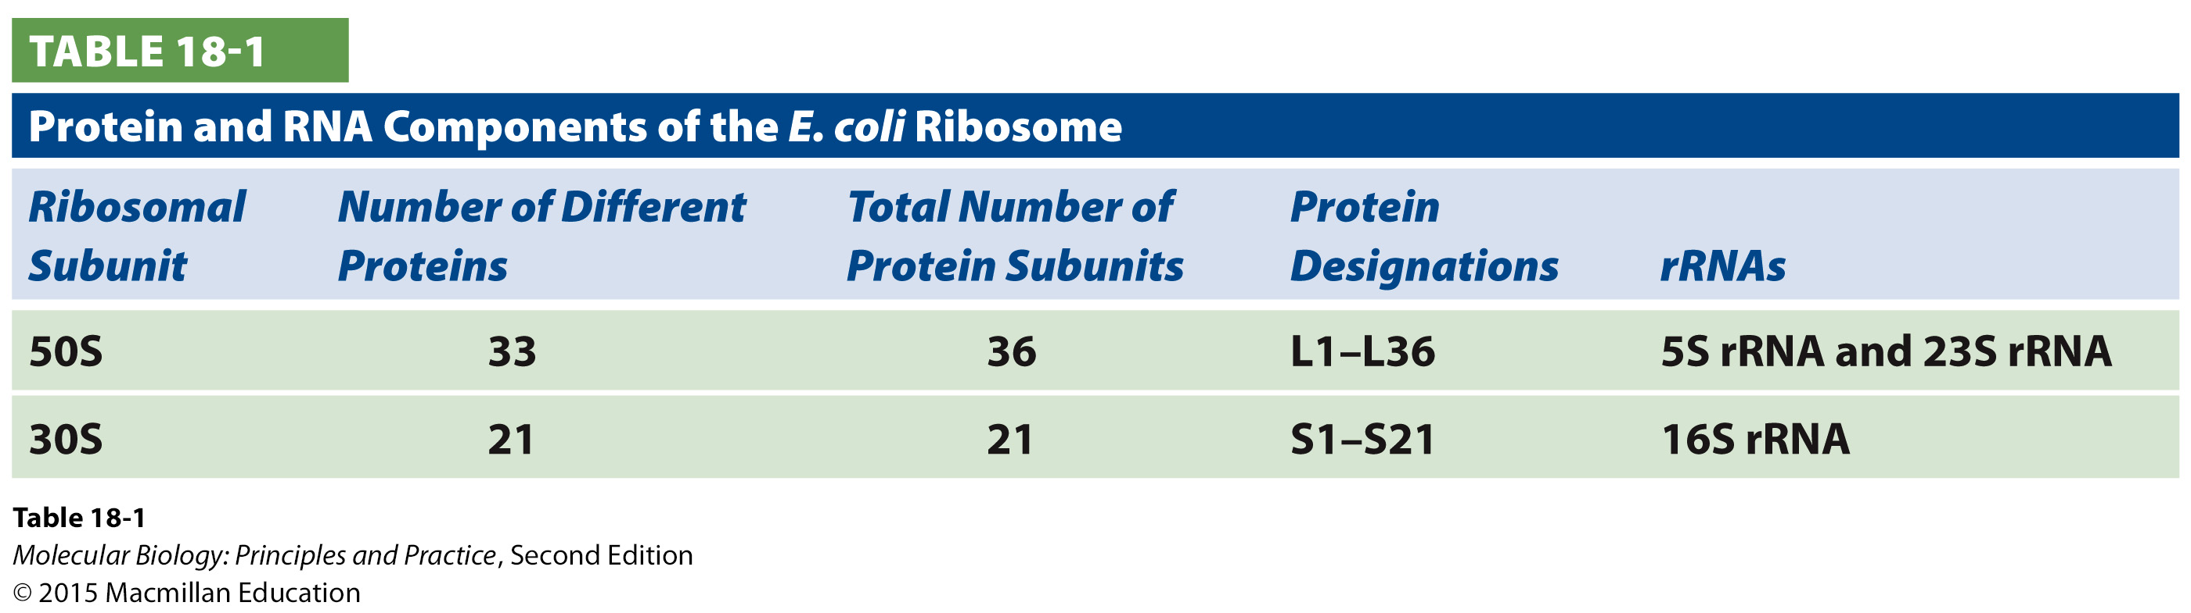
Nomenclature note: “ribosomal proteins” do not include IFs, EFs, RFs, RRF

Slide 28
Other things that must happen during or after translation for proper protein function
Protein folding
Sub-cellular localization
Post-translational modification

Slide 29
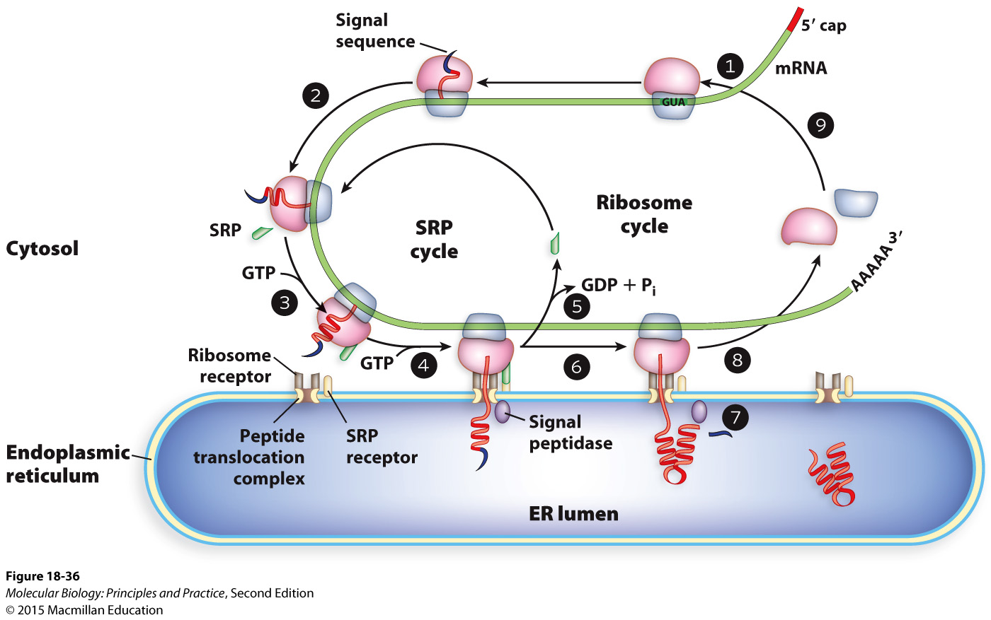
Signal sequences target partially translated proteins to the ER

